Slide 1

DATA STRUCTURE AND ALGORITHM
PROJECT ON PRIORITY QUEUE
Submitted to : Dr. Md. Rezaul Karim
Group Members: Md. Farhan Tonoy ID: 2021-1-60-126
Ariful Anik
ID: 2021-1-60-028

Slide 2
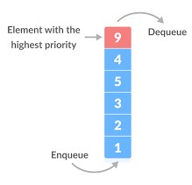


Priority Queue
A priority queue is a queue in which interstation and deletion of items from position in the queue are done based on some property
What Priority queue Contains?
It Contains data which have some preset priority.
Depends on a priority.
Insertion andDeletetion.
Interstation is performed in order of arrival and deletion is performed based on the priority.

Slide 3
Types of Priority Queue
Min Priority Queue
Min-priority queue: in a min-priority queue, a lower priority number is given as a higher priority
Max Priority Queue
Max-priority queue: in a max-priority queue, a higher priority number is given as a higher priority

Slide 4
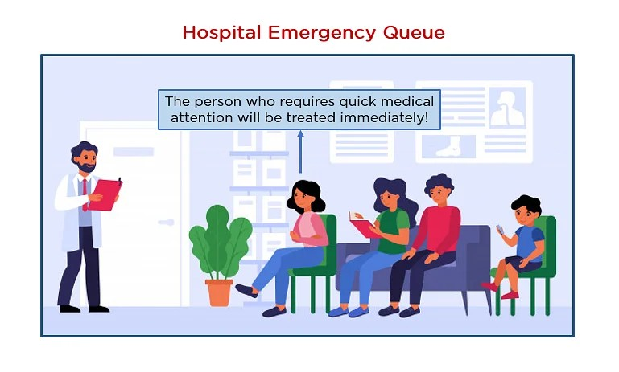
REAL LIFE APLLICATION
The hospital emergency queue is an ideal real-life example of a priority queue. In this queue of patients, the patient with the most critical situation is the first in a queue, and the patient who doesn’t need immediate medical attention will be the last. In this queue, the priority depends on the medical condition of the patients.

Slide 5
CORE DATA STRUCTURE
Module in c
Link-list Implementation
Heap
Linked list-Implementation
Queue
File-Handiling

Slide 6
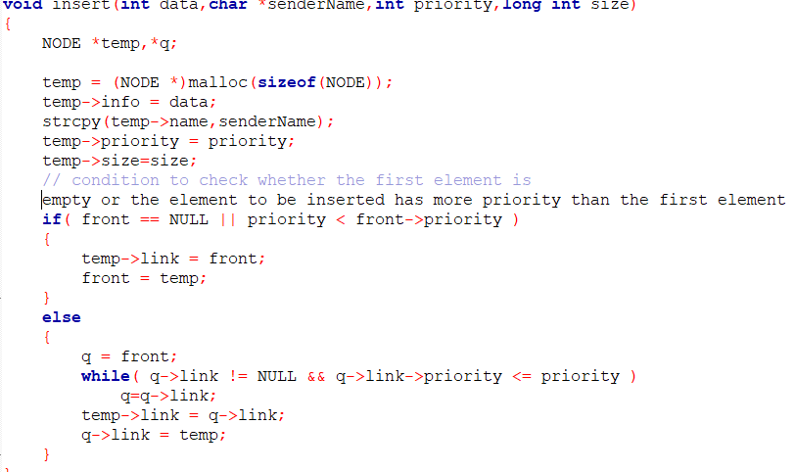
INSERT FUCTION

Slide 7
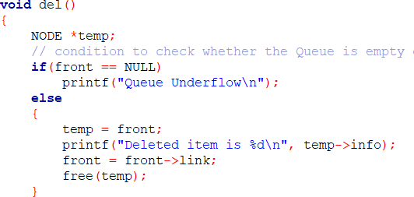
DELETE FUCTION

Slide 8
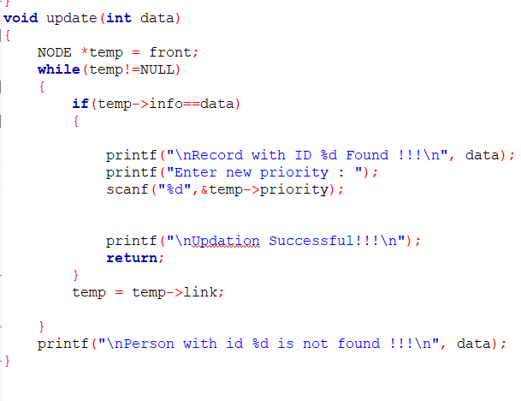
VOID FUCTION FOR UPDATING DATA

Slide 9
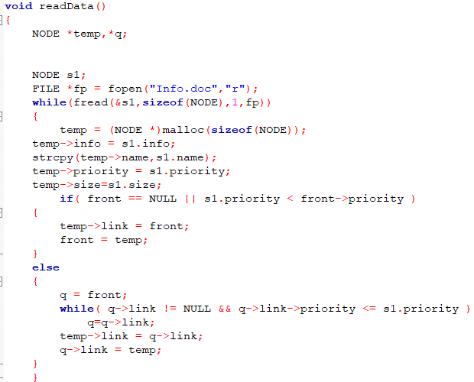
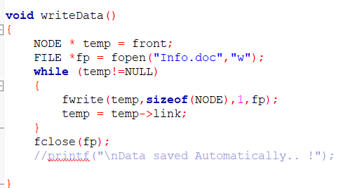
FILE MANAGEMENT

Slide 10

THANK
YOU

